Slide 1

“An Overview of Research Papers Analysis Regarding Road Scene Analysis”
Supervisor : Md. Tamim Hossain
Presented By : Samiha Mehjabin

Slide 2

Studied Papers & Identified Categories
Road Hazards
Pedestrians behaviour
Overall Scene Understanding
Motion detection of the vehicles in front
2

Slide 3
Identified Patterns
✔ Pathole detection and manhole cover’s risk analysis
✔ Pedestrians action prediction
✔ overall scene analysis(detecting object, lane,
drivable area)
✔ speed detection of vehicles in front
✔ action prediction of the vehicle in front
2

Slide 4
Category 1: Road Hazards-
Key Insights and Findings:
The YOLOX-ECA model achieves high accuracy in manhole-cover condition detection.
ECA attention helps network focus on key manhole-cover features.
The improved YOLOv8 model enhances pothole detection in complex scenes.
Multi-scale feature extraction improves robustness in varied road environments.
Both models work effectively using dash-cam/vehicle mounted images
2
3

Slide 5
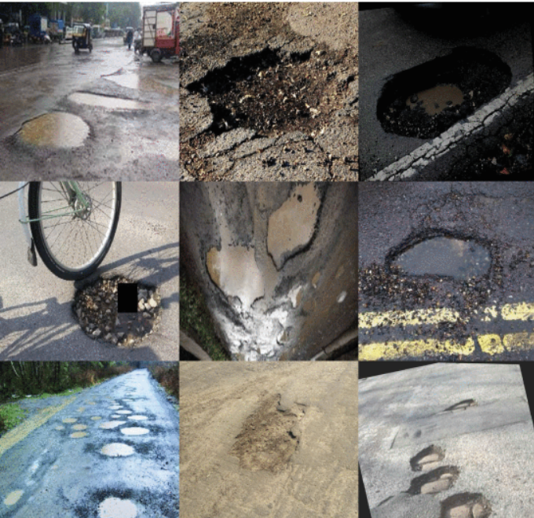
Example & Findings (Category 1) :
Example Outputs:
Road cracks
Lane-marking degradation
Waterlogging
Road debris
General road-surface damage
System Output Examples:
Pothole dataset in complex scenarios.
Manhole Condition Alert.
Pothole Hazard Warning.
Road Surface Health Report.

Slide 6
Conclusion & Implementation:
The YOLOX-ECA and YOLOv8 models accurately detect manhole-cover defects and potholes using attention and multi-scale features. These techniques enable reliable, real-time road-hazard monitoring from simple camera inputs.
To detect road defects.
To identify hazard patterns in scenes.
To track recurring hazard locations.
2
3

Slide 7
Category 2: Pedestrians Behaviour-
Key Insights and Findings:
Uses body and head orientation for action understanding
Relies on spatio-temporal ego-motion for trajectory prediction
Applies Hop Interaction for long-range relations.
Uses a Self-Supervised Module to reduce errors.
Employs goal-driven dynamics for realistic paths.
2
3

Slide 8
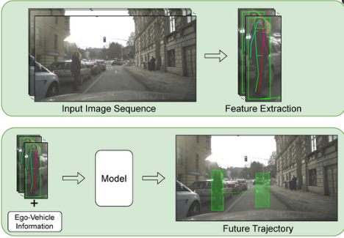
Example & Findings (Category 2) :
Example Outputs:
Uses behavior cues + past positions.
Considers ego-vehicle motion.
Models social interactions.
Uses goal-driven/self-supervised paths.
Recent motion history guides prediction.
System Output Examples:
Pedestrian trajectory prediction method (BA-PTP) utilizes behavioral features such as body and head orientation as well as pose in addition to body and head bounding boxes. These features are combined with ego-vehicle information to predict the future bounding boxes of a pedestrian in the image.

Slide 9
Conclusion & Implementation:
Behavioral cues, ego-motion, and graph interactions improve pedestrian-trajectory accuracy. These methods enable more realistic and reliable road-scene understanding.
Use behavioral cues to detect risky pedestrian–vehicle interactions
Apply spatio-temporal features for analyzing crowded intersections.
Integrate goal-driven motion patterns to identify potential collision zones.
2
3

Slide 10
Category 3:Overall Scene Understanding-
Key Insights and Findings:
Multi-task learning improves shared feature representation in road scenes
A single network enhances lane, object, and drivable-area understanding
Bi-Mapper fuses front-view features with geometric priors.
Dual-stream design reduces perspective distortion in BEV mapping.
Asynchronous mutual learning boosts cross-view consistency.
2
3

Slide 11
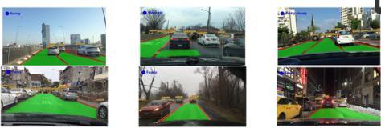
Example & Findings (Category 3) :
Example Outputs:
Detects objects and the drivable area simultaneously using a single network.
BEV Mapping provides accurate top-down location.
Data fusion enables risk assessment.
The results inform driving decisions.
System Output Examples:
(a) Detection results of the Multi-Task Learning network in multi-weather road conditions.
(b) Detection results of BEV Mapping in multi-scenario road conditions.

Slide 12
Conclusion & Implementation:
Multi-task learning and dual-stream BEV mapping improve feature representation and scene consistency in road understanding. Together, they enhance lane, object, and drivable-area perception with reduced distortion.
Use shared features to detect new road elements.
Apply BEV fusion for clearer hazard mapping.
Integrate multi-task branches for multiple scene outputs.
2
3

Slide 13
Category 4:Motion detection of the vehicles in front-
Key Insights and Findings:
Scene-flow improves motion detection for fast and slow road users.
Heterogeneous data enhances multimodal trajectory prediction.
Physical constraints ensure realistic vehicle paths.
Graph interactions capture vehicle influence over time.
DGCN models multi-agent relationships for better trajectory accuracy.
2
3

Slide 14
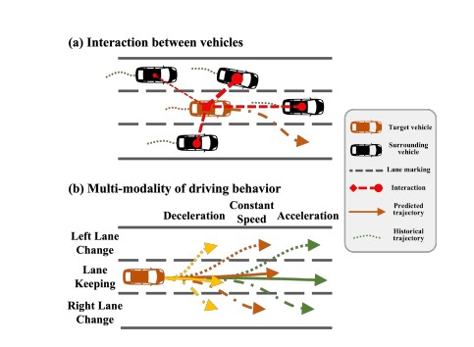
Example & Findings (Category 4) :
Example Outputs:
Tracked objects: Car A (fast), Car B (slow), Pedestrian (crossing)
Predicted paths: Car A may change lanes (70%), Car B stays straight (90%)
Interaction graph: Pedestrian influences both vehicles, Car A influences Car B
System decision: “Slow down, prepare for Car A’s lane change—pedestrian crossing ahead.”
System Output Examples:
(a) Real-time Motion Status.
(b) Probabilistic Path Prediction.
(c) Interaction Graph Status.

Slide 15
Conclusion & Implementation:
Advanced techniques like Scene-Flow, Multimodal Data, and Graph Networks collectively improve motion detection and trajectory prediction accuracy. By combining these methods, the system can anticipate multiple future scenarios while ensuring the predicted vehicle paths are physically realistic. This enables highly reliable and proactive safety decisions for autonomous driving.
Identify Potential Hazard Zones
Optimize Road Layouts
Improve Real-Time Safety
Predict Risk in Complex Scenarios
2
3

Slide 16
THANK
YOU
PREMIERE UNIVERSITY

